Slide 1

Grammar: Tenses
How to improve your use of verb tenses in writing
Writing Support Desk, Fall 2017
writingsupport@uwindsor.ca

Slide 2
4 types of tenses
Simple tenses
past
present
future
Perfect tenses
past
present
future
Progressive/
Continuous tenses
past
present
future
Perfect progressive
tenses
past
present
future

Slide 3
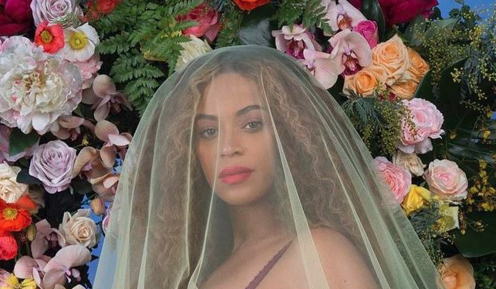
Simple tenses
past
present
future
Yesterday, Queen B announced her pregnancy with a maternity photoshoot.
She already appears in the news every day.
Next week, dozens of maternity photographers will copy her shoot.

Slide 4

The Simple Past
indicates exactly when an action or event took place
in the past.
Amy asked me on a date last week.
Last night, we saw The Avengers 4.

Slide 5

The Simple Past
also describes actions and/or events that are
now completed and no longer true.
I lived in Portland in 2012.
(I no longer live in Portland)
I biked to work every day in my 20s.
(I no longer bike to work very often).
For regular verbs, just add –ed

Slide 6
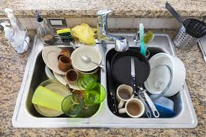
The Simple Present
expresses a habit or often-repeated action.
Look out for adverbs like often, seldom, sometimes, or never.
She sometimes sends me the funniest Snapchats.
My roommates always leave their dishes in the sink.

Slide 7
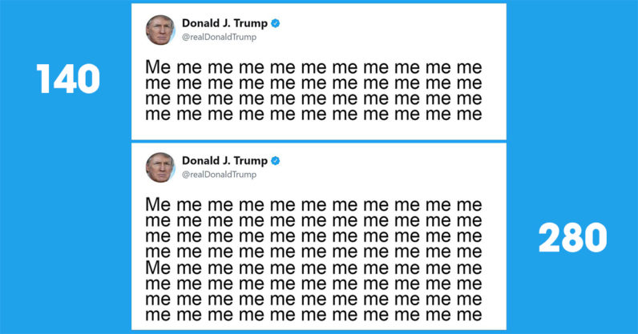
The Simple Future
describes future actions
will + verb
am/is/are+ going to
Twitter will give all users more characters per tweet tomorrow.
The company is going to regret this decision.

Slide 8


Slide 9
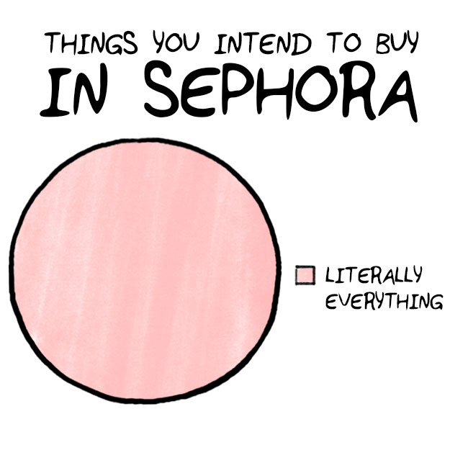
Perfect tenses
show when an action happened in relation to another action, using the helping verb to have.
past
present
future
100 people
had liked
my new Instagram post before I even checked my phone.
She has worn a new lipstick colour every day this week.
By the end of the month, Jo will have spent over $800 at Sephora.

Slide 10

The Past Perfect
describes completed events that took place in the past before another past event.
had auditioned
he made it
Bryan had auditioned for American Idol 8 times before he made it.
Add had before the verb and –ed to regular verbs.

Slide 11
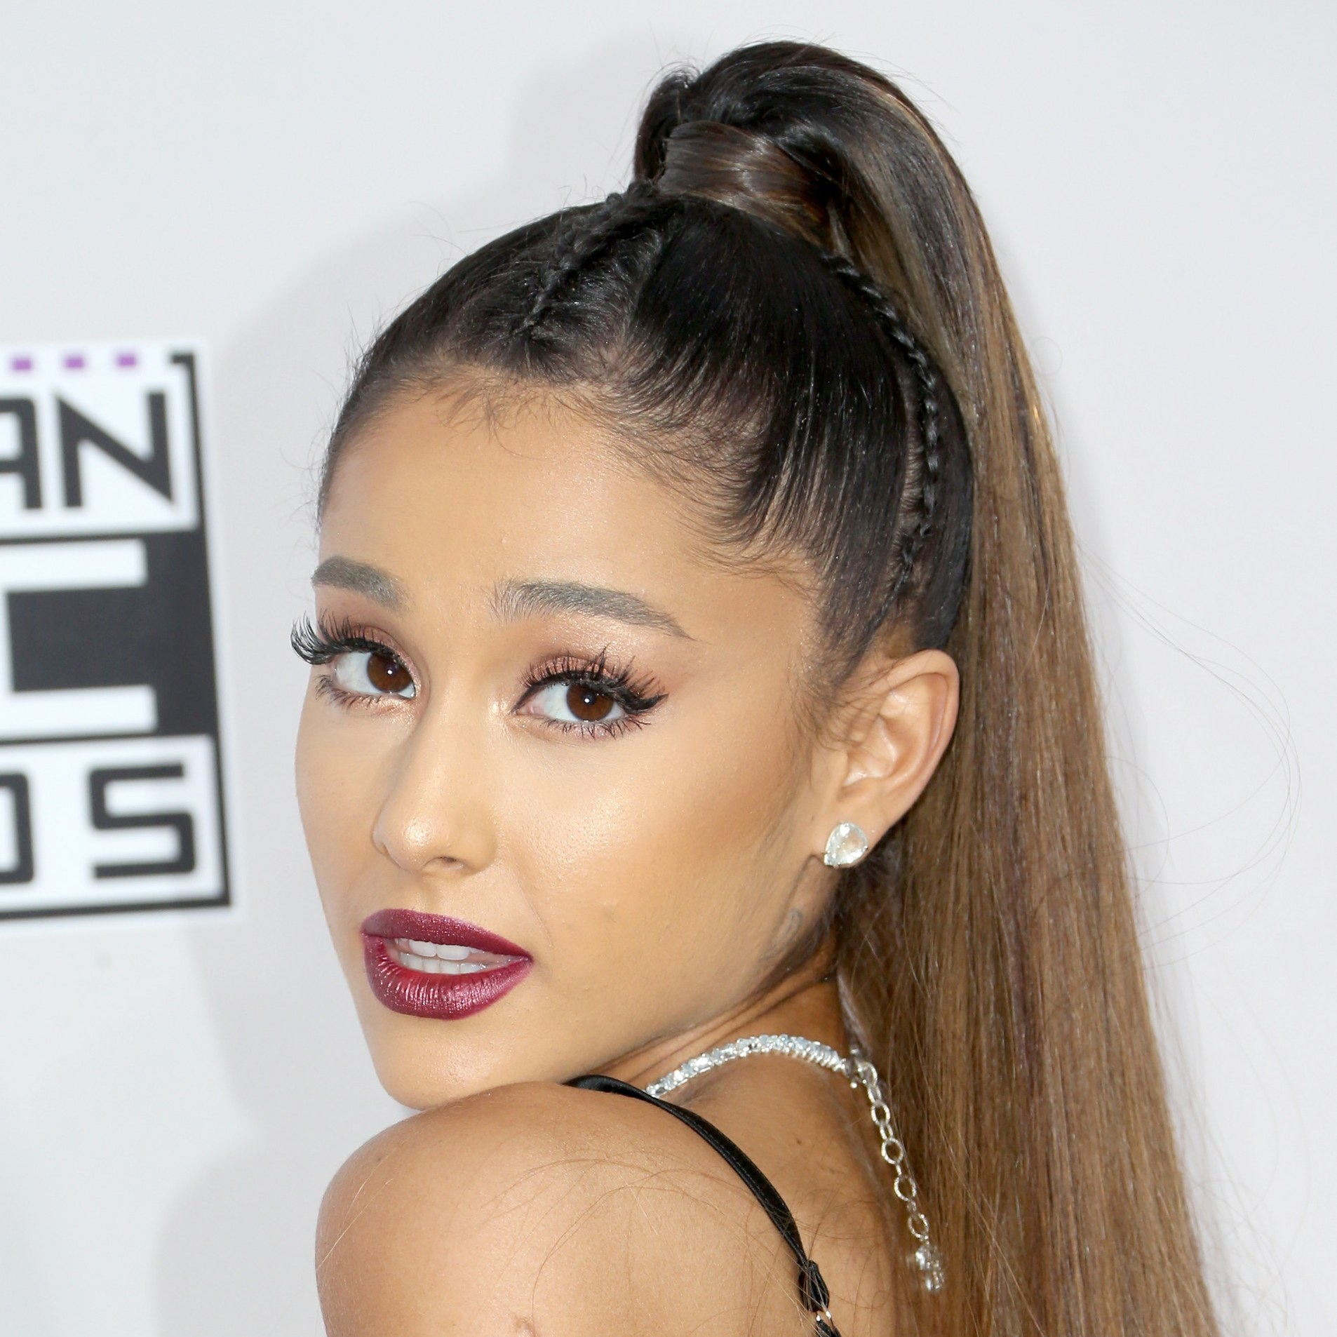
The Present Perfect
talks about an event that began in the past and continues up to the present.
Ariana has worn her hair in a ponytail for five years.
(She started wearing her hair that way five years ago and still does).
Add has/have before the verb and –ed to regular verbs.

Slide 12
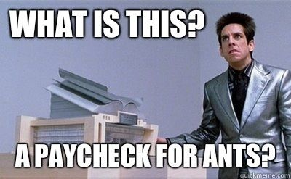
The Present Perfect
also talks about an event that was completed in the past but the specific time is not important.
He has already spent his entire pay check.

Slide 13
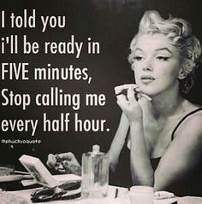
The Future Perfect
describes an event or action that will be completed before another event or time in the future.
going to bed
James is ready
We will have gone to bed by the time James is ready to go out.

Slide 15
Progressive Tenses
aka continuous tenses show that an action is or was ongoing or continuing at the same time as something else.
past
present
future
Yesterday, Emma
was playing
Call of Duty when I asked her to go out.
She is staying home from work today to finish her game.
She will be missing my party this weekend because she bought the sequel.
Use to be (am/is/are, was/were, will be) and the –ing form of the verb

Slide 16
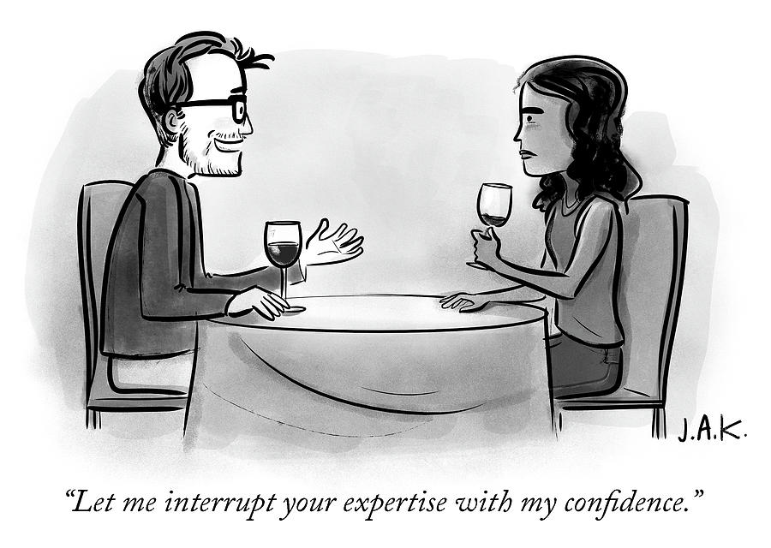
The Past Continuous
is often used with the simple past to show that one action was in progress when another action occurred.
explaining
research
interrupting
I was explaining my research when he interrupted me.
Add was/were before the verb and –ing to the verb.

Slide 17
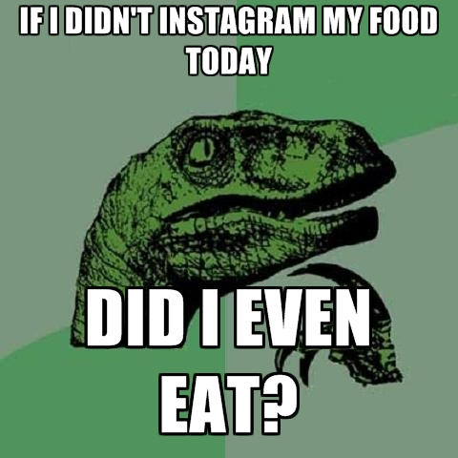
The Past Continuous
is also used to talk about an event that was in progress at a specific point of time in the past with an emphasis on its duration.
We were scrolling Instagram for three hours last night.

Slide 18
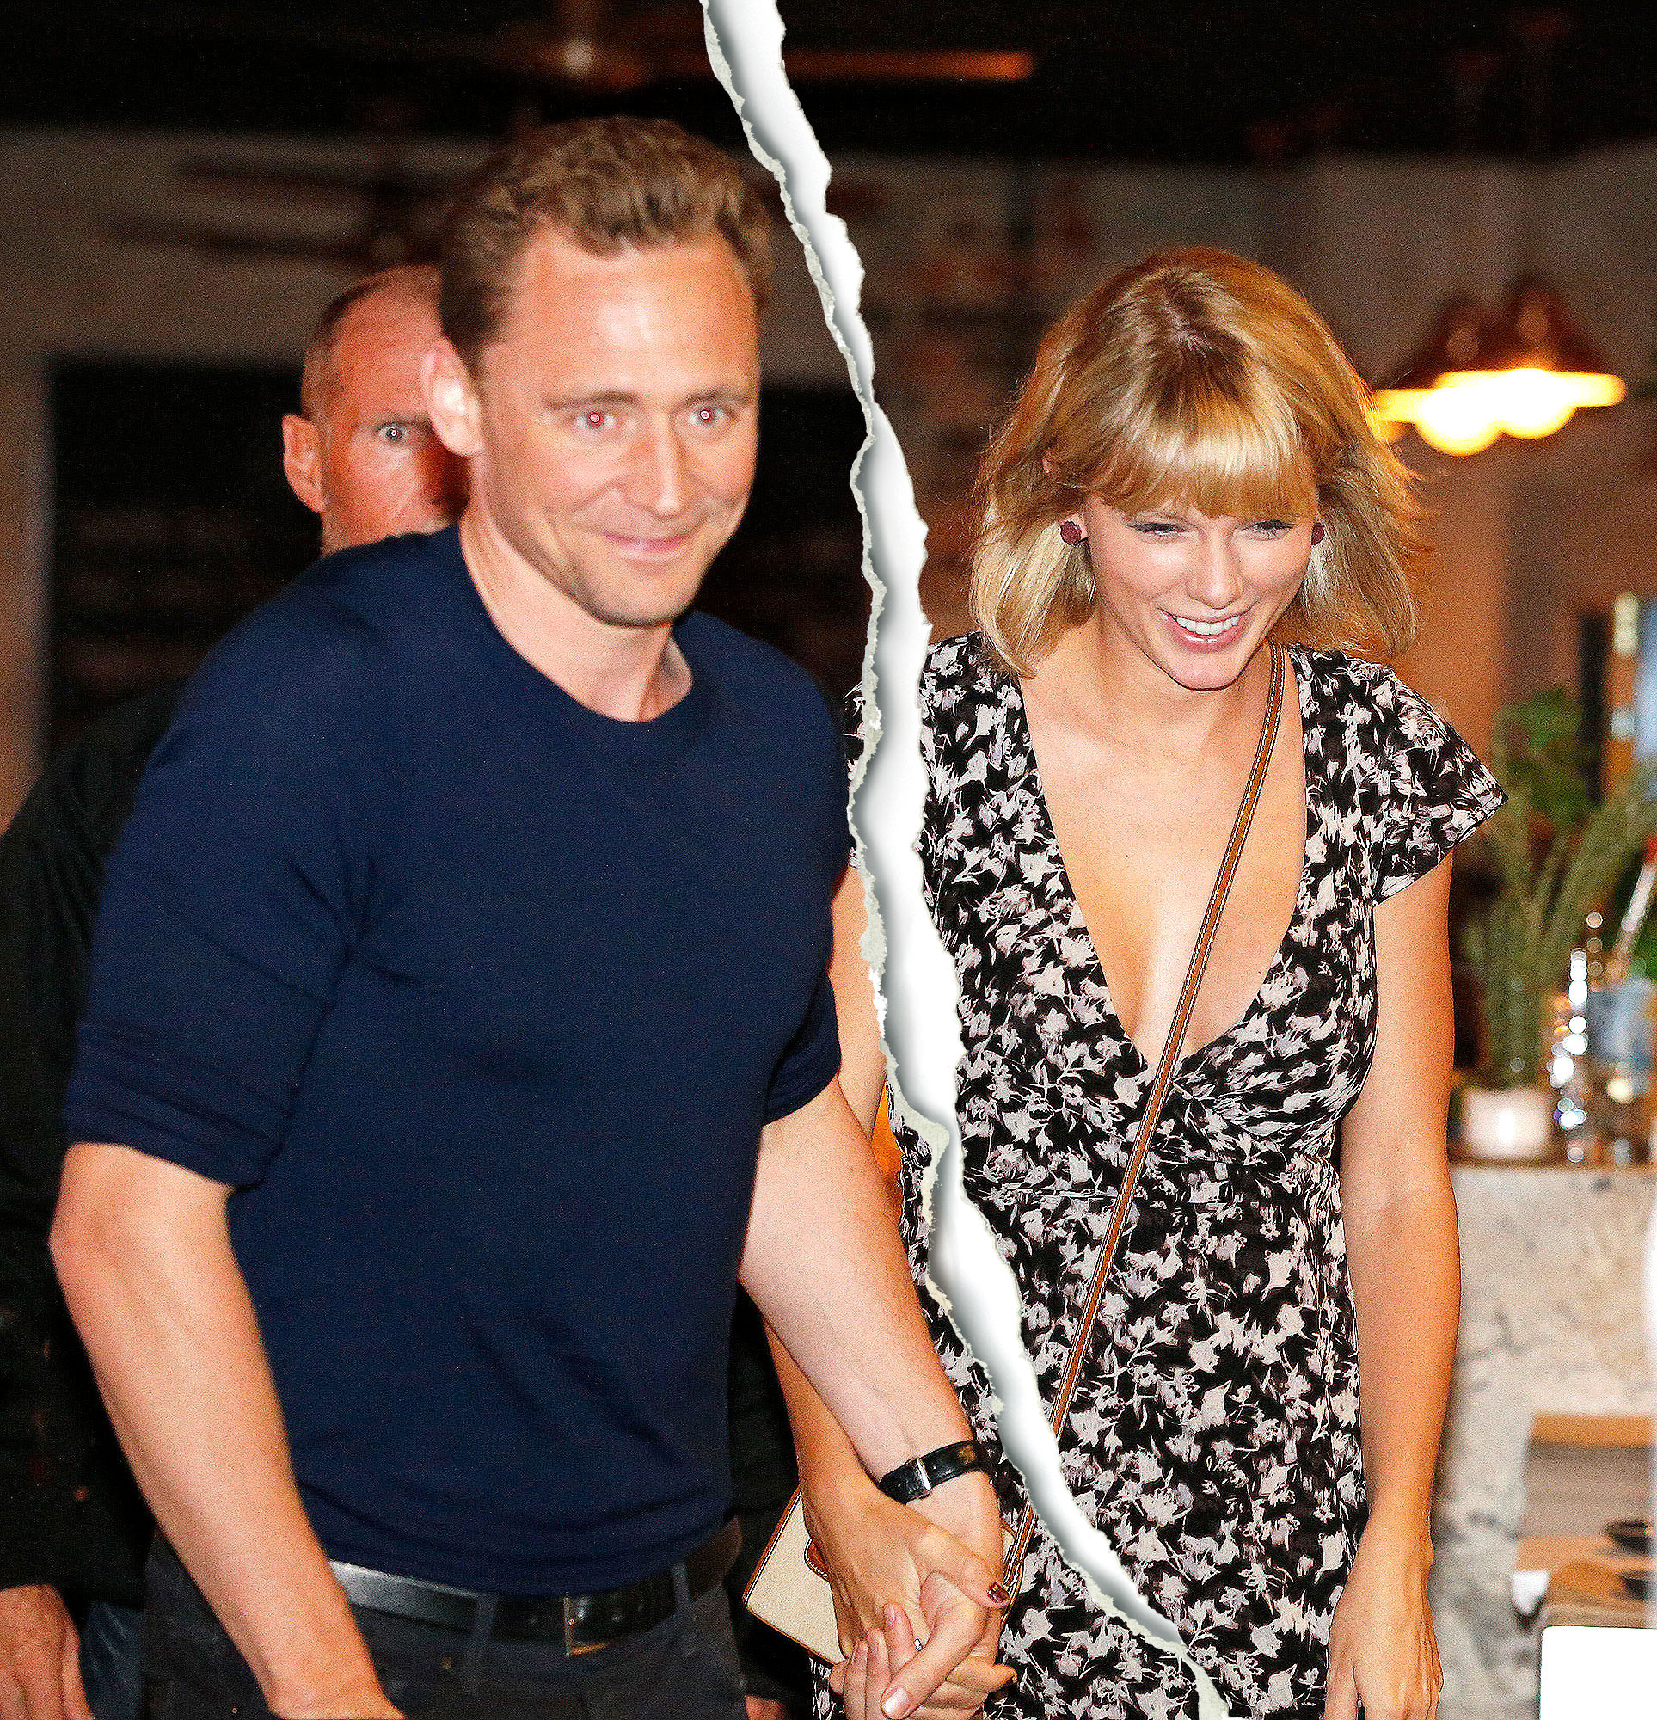
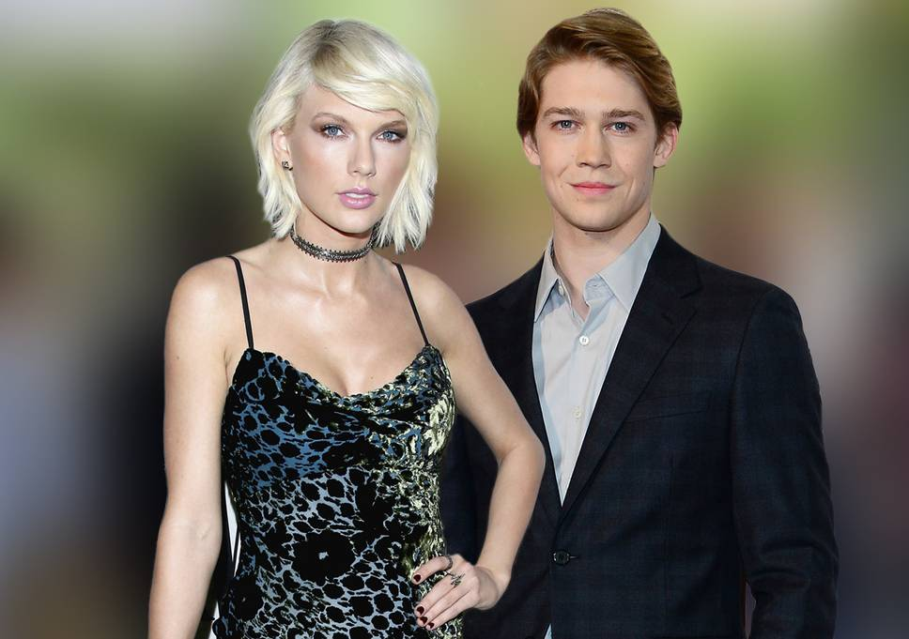
The Present Continuous
is used to describe an action that is occurring right now
Taylor Swift is dating a British actor again.

Slide 19

The Future Continuous
is used to describe an action that will occur over a period of time at a specific point in the future.
the time you leave
sleeping starts
I will be sleeping by the time you leave for the party.
Use will be + ing

Slide 21
Perfect Progressive Tenses
are a combination of perfect (completed before) and progressive (ongoing) tenses. They show that something began, continued, and ended before another action.
past
present
future
My younger brother
had been watching
Netflix for 15 hours when our mom unplugged the internet.
She has been refusing to reconnect the internet all day.
I will have been waiting three hours to watch my favourite show by the time she leaves for work.

Slide 22
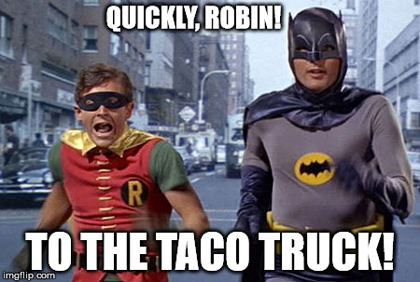
Past Perfect Continuous
is used to emphasize the duration of an action that was completed before another event or action in the past.
3 hours
started
walking
found the taco truck
She had been walking around the neighbourhood for three hours before she finally found the taco truck.
Add had+ been + verb + –ing.

Slide 23
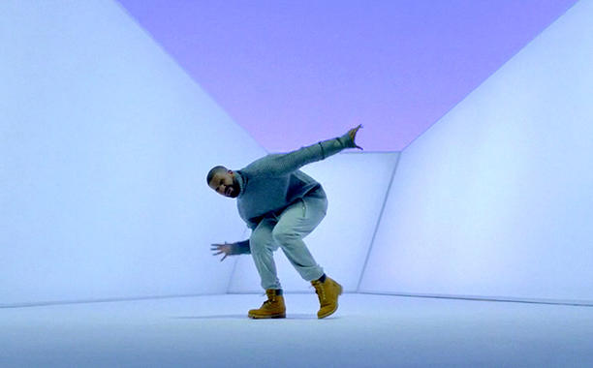
Present Perfect Continuous
is used to describe the duration of an action that began in the past and continues in the present.
all afternoon
starts dancing
still dancing now
Drake has been dancing all afternoon.
(He is still dancing).

Slide 24

Present Perfect Continuous
is also used to describe events that have been in progress recently and are rather temporary.
started travelling
2 months
They have been travelling in Australia for the last two months, but they will come home soon.
Add has/have + been + verb +-ing

Slide 25

Future Perfect Continuous
describes an action that has been in progress for a duration of time before another event or time in the future.
8 years before he finishes
he finishes law school
By the time he finishes law school, he will have been living on macaroni and cheese for eight years straight.
Add will + has/have + been + verb +-ing

Slide 27
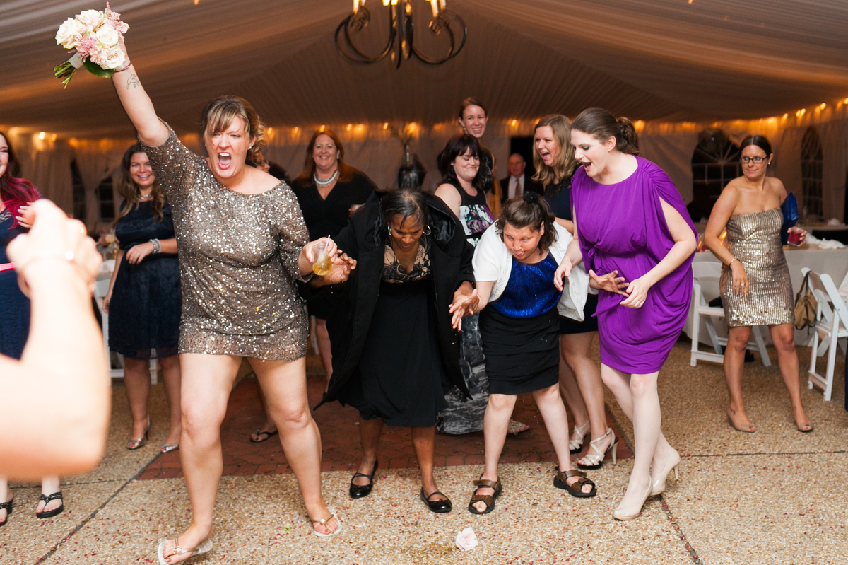
Avoiding shifts in verb tense
INCORRECT
She caught the bouquet and throws it to her sister.
CORRECT
She caught the bouquet and threw it to her sister.
or
She catches the bouquet and throws it to her sister.

Slide 28
 | Simple | Progressive | Perfect | Perfect Progressive
Present | always, every..., never, normally, often, seldom, sometimes, usually, frequently, the first time | now, right now, this week, at the moment, Listen!, Look!, just, just now | (un)till now. up to now, just, since, ever, never, always, so far, many times/weeks/years... for three minutes/hours/..., lately, recently | for the past year/month/week/..., for 2 weeks, up to now, all day, since 1945, How long?, the whole week
Past | yesterday, minutes ago, last year, before, one year ago, finally | while, when, as long as | already, before, after, just, never, not yet, once until then/last week/... | before, for one hour/week/month/..., since, all day, the whole day
Future | tomorrow, tonight, next week, soon, in the future, afternoon, someday | when, after, before, as soon as, next week, all day long, for..., at this time tomorrow | by the time you go (somewhere) by the time you do (something) | by the time, for 5 minutes/days/weeks/...
Clue words can help us choose the correct tense!

Slide 29
References
Slideshare.net
Englishgrammar.org
Cookieenglish
http://trainingesl.blogspot.ca/2012/04/12-tenses-of-english-signal-clue-words.html

